Slide 1

Y’App Techno Lab
GeoHelp V1

Slide 2
Introduction the our organization
* Tow Members
Yash J Patel
Yash p Patel
Familiar with different languages
* Developing Organization
Java
PHP
HTML
.NET
Android
Ios
Had Completed B.Tech Computer Engineering
Working experience in college live projects
Recently Done Government Project
Want support from reputed clients as yours Industry

Slide 3

Why We Need this Kind of application ?
For Security purpose
Increase rate of digitalization in the current generation
Decrease crime rate
Get help in the time of emergency

Slide 4
GeoHelp V1
Why we use here GeoHelp V1 ?
This Version has limited functionality
Functionality updated in next 3 months…
Next version should be more efficient & more secure.
In that latest version we uses new functionalities

Slide 5
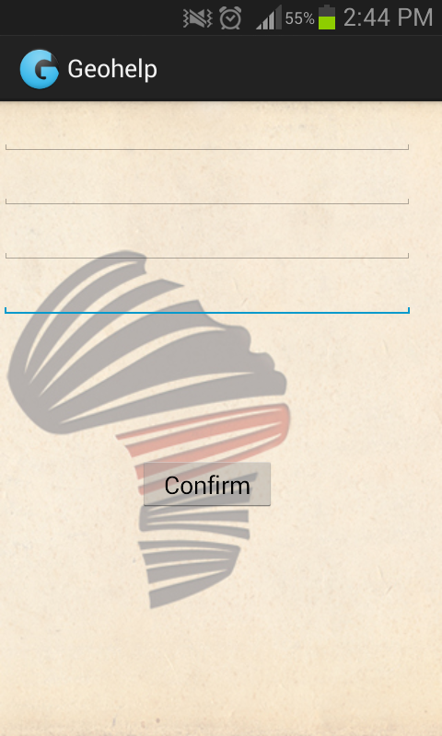
About this version
Basic Functionality
We can add only four numbers

Slide 6
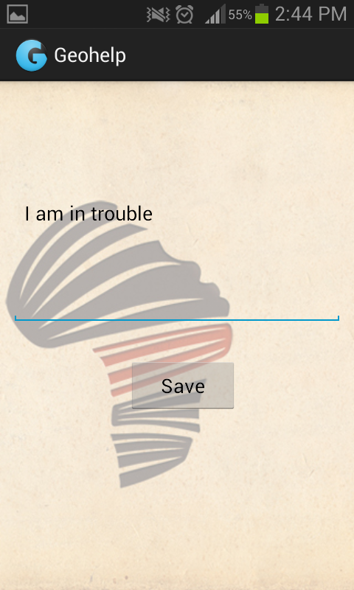
We can add or use default message

Slide 7
We have provided a clickable button
to sent the emergency message

Slide 8
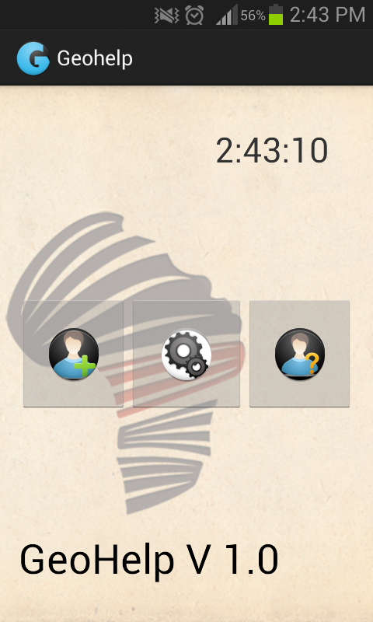
This is the main menu of the application.

Slide 9
If this application will updated then
this application should get updated functionality :
This application will automatically add those numbers which are regularly in use.
This application will accept the message by user
This application will provide two more automated functionality :
* Message will sent by only shaking device
* The application will automatically find that user’s current location
Then it will sent only that user who most nearest person to that user.
*Message will sent by continuously clicking on power button.

Slide 10
At initially level
We can download This application from Google play store for free of cost .
This application uses internal storage of device to save those data which user filled
The next Version
The next version will provide more security because it will save the number at GeoHelp Server.
The next version will navigate the user with use of Google maps.

Slide 11
Thank You for listening us

